Slide 1


Veteran-Facing Services – Digital Health Modernization
1095-B Tax Form
Kickoff Meeting
20 January 2022

Slide 2
Objectives for today
Get to know the team (10 min)
Review 1095-B Project Overview on Mural (1 hour 25 min)
Align on approach (20 min)
Define next steps and wrap up (5 min)
Kick-off: 1095-B Tax Form

Slide 3


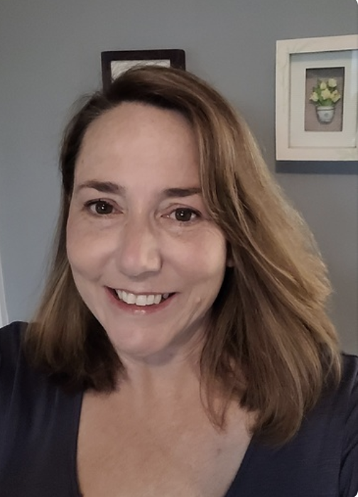



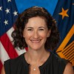








Get to know the team
Core Team
Executive Team
Product
Engineering
Ashley Castillo Washington DC Product Manager Lead
Jordan White Dallas, TX Product Manager
Tami Corson
North Carolina
Scrum Master
Jared Cooke Los Angeles, CA Front End Developer
Nadya Primak Washington DC Engineer
Jeff Scheire
MO Studio
Marcy Jacobs
McKinsey
Kevin London frog
Design
Kit Casey Boston, MA Design Director
Carl Dickerson Atlanta, GA Content Strategist and Plain Language Content Creator
Grace Hong New Jersey Experience Designer
James Lewis Austin, TX Accessibility and UX Research Lead
Jesse Singh Minneapolis, MN UX Design Lead
Will Reynolds Serve
Ben Morris
Pluribus
*Day to day workiing team will be adjusted through project lifecycle if new skillset needs arise
Kick-off: 1095-B Tax Form

Slide 4
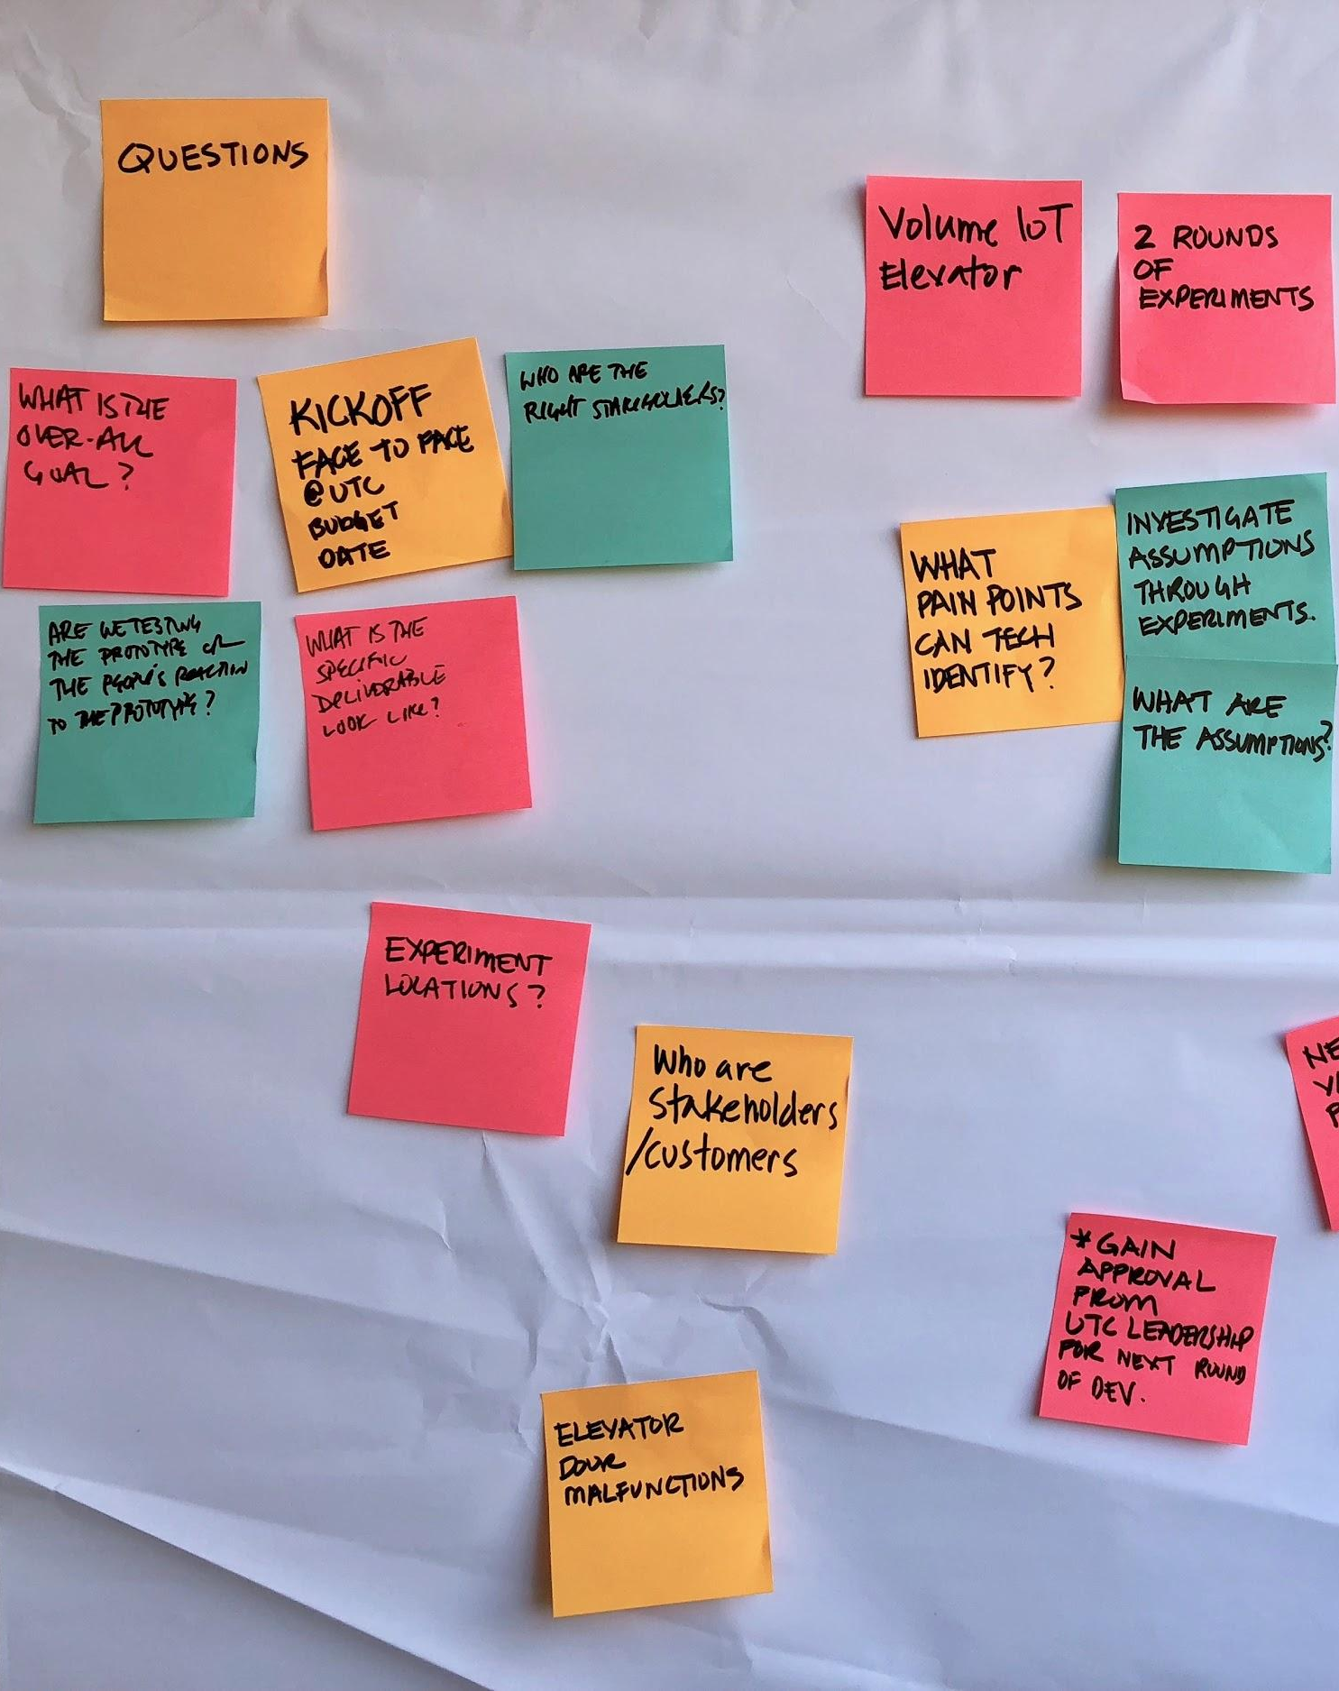
Project objectives
Digitize 1095-B form on va.gov so veterans can view the form, download the form, & be able to upload or print it for their taxes.
Create space on va.gov production, with all steps required for a veteran to download their 1095-B form
Increase availability of self-service tools
For discussion:
1) What is the core pain point we are trying to solve?
2) What is the current state?
3) What is the experience of the future state?
4) What stakeholders or groups are key for us to loop in?
5) What risks or potential challenges do we want to keep an eye on?
Move to Mural Board for discussion
Kick-off: 1095-B Tax Form

Slide 5
1095-B Tax Form
Work plan

Slide 6



Our approach to veteran-centered design
A creative problem-solving approach to problem-solving that starts with people and ends with innovative solutions that balance the three lenses.
Desirability
User Experience
& Design
Feasibility
Viability
Product & Delivery
Engineering & Development
Kick-off: 1095-B Tax Form

Slide 7
Workplan overview
Sprint 0
Sprint 1
Sprint 2
Sprint 3
Sprint 4
Sprint 5
Week 1: 01/20 – 01/26
Week 2: 01/26–02/02
Week 3: 02/02 – 02/09
Week 4: 02/09 – 02/16
Week 5: 02/16 – 02/23
Week 6: 02/23 – 03/02
Week 7: 03/02- 03/09
Week 8: 03/09 – 03/16
Week 9: 03/16 – 03/23
Week 10: 03/23 – 03/30
Product & Delivery
Build backlog
Create Change Management or Communications Plan
Handover plan implementation; prepare for launch
PIV Onboarding
Product roadmap
Product Launch Collaboration Cycle (as needed)
Immersion & onboarding
User Experience & Design
Immersion & onboarding
Testing prep & recruiting
Testing prep & recruiting
Testing prep & recruiting
Create post-MVP design refinements
Voice of Veteran
Voice of Veteran
Voice of Veteran
PIV Onboarding
Wireframes & Design
Design iterations
Design iterations
Design QA
User flows
Engineering & Development
Create tech discovery plan
Data discovery
POC for data flow
Build solution (form and data connections, storage, etc.)
Test & Refine
Immersion & onboarding
Define data flows - Systems mapping
UAT
Collaboration Cycle
Let’s discuss touchpoints
Staging Deployment
MVP Launch

Slide 8
1095-B Tax Form
Scrum cadences

Slide 9
Calendar overview
We are here
Launch
Week of
Monday
Tuesday
Wednesday
Thursday
Friday
January
01/16
17
18
19
20 Project Kick Off
21
01/23
24
25
26 Sprint 0 End;
Sprint 1 Start
27
28
February
01/30
31
01
02
03
04
02/06
07
08
09 Sprint 1 Demo; Sprint 2 kickoff
10
11
02/13
14
15
16
17
18
02/20
21 President’s Day Holiday
22
23 Sprint 2 Demo; Sprint 3 kickoff
24
25
March
02/27
28
01
02
03
04
03/06
07
08
09 Staging Deployment; Sprint 3 Demo; Sprint 4 Kick Off
10
11
03/13
14
15
16
17
18
03/20
21
22
23 Sprint 4 Demo; Sprint 5 Kick Off
24
25
03/27
28
29
30
31
April 1 MVP Launch
Kick-off: 1095-B Tax Form

Slide 10
Each sprint runs two weeks, starting on Thursdays
Note: Timing subject to change based on availability
With VA-PO and stakeholders
With VA-PO
With core team only
Wednesday
Thursday
Friday
Monday
Tuesday
Wednesday
Thursday
Friday
Monday
Tuesday
09:00 – 10:00 AM
10:00 – 11:00 AM
11:00 – 12:00 AM
Sprint Demo
Daily Standup
Daily Standup
Daily Standup
Daily Standup
Daily Standup
Daily Standup
Daily Standup
Daily Standup
Daily Standup
12:00 – 1:00 PM
1:00 – 2:00 PM
Sprint Retro
PO Sync
Backlog Grooming (Internal)
PO Sync
Backlog Grooming (with stakeholders)
PO Sync
Backlog Grooming (Internal)
PO Sync
2:00 – 3:00 PM
Sprint Planning
Design Review
Design Review
Design Review
3:00 – 4:00 PM
4:00 – 5:00 PM
Demo prep
*Sprint cadence shown is example; team to align with VA-PO and stakeholders and confirm all dates/timings before sending invites
Kick-off: 1095-B Tax Form

Slide 11
Meetings with Tracey or stakeholders outside of core team
Meeting | Attendees | Objectives | Outputs
PO Sync | Tracey, Jordan, Ashley, Kit (optional) | Align with Tracey on upcoming sprint goals and latest roadmap Review sprint progress for this sprint thus far Get directional guidance on key questions | Refined sprint goals Updated roadmap Prioritized backlog to be taken into next sprint planning
Design Review | Tracey, Kit, Grace, Jesse, James, Jared, Ashley (optional) | Present latest designs in this sprint Get feedback from Tracey | Feedback that can be turned into user stories for design and prioritized
Sprint Demo | Tracey, full working team, all stakeholders invited | Present all work accomplished in this current sprint for feedback | Feedback from stakeholders turned into user stories that can be prioritized for upcoming sprints
Backlog Refinement | Tracey, Kit, Jordan, additional team members as needed based on story, key stakeholders TBD | Discuss stories, designs, or work to be done in upcoming sprints to refine the user story | User stories for future sprints are updated, meet Definition of Ready, and can be pulled into future sprints
Meeting
Attendees
Objectives
Outputs
To discuss work in the current sprint
PO Sync
Tracey, Jordan, Ashley, Kit and/or Jesse (optional)
Align with Tracey on upcoming sprint goals and latest roadmap
Review sprint progress for this sprint thus far
Get directional guidance on key questions
Refined sprint goals
Updated roadmap
Prioritized backlog to be taken into next sprint planning
Design Review
Tracey, Kit, Grace, Jesse, James, Jared, Ashley (optional)
Present latest designs in this sprint
Get feedback from Tracey
Feedback that can be turned into user stories for design and prioritized
Sprint Demo
Tracey, full working team, all stakeholders invited
Present all work accomplished in this current sprint for feedback
Feedback from stakeholders turned into user stories that can be prioritized for upcoming sprints
To discuss work for future sprints
Backlog Grooming with stakeholders
Tracey, Kit, Jordan, Jesse, additional team members as needed based on story, key stakeholders TBD
Discuss stories, designs, or work to be done in upcoming sprints to refine the user story
User stories for future sprints are updated, meet Definition of Ready, and can be pulled into future sprints
Kick-off: 1095-B Tax Form

Slide 12
1095-B Tax Form
Next steps

Slide 13
Next steps
Discuss any revisions to workplan and current sprint progress at first PO Sync on Tuesday 1/25
Align on next sprint’s goal with Tracey and kick off next sprint on Wednesday 1/26
Decide on attendees for sprint demos and backlog refinements and send invites by Friday 1/28
Kick-off: 1095-B Tax Form

Slide 14
Appendix

Slide 15
Roles and responsibilities
CLIN 0001AC
Role
Responsibility
Name
Organization
Role | Responsibility | Name | Organization
Executive Sponsors | Continuously sponsor and guide team in defining and delivering to the project goals and scope. Champion the product within the larger ecosystem. Make connections to inform the product and help the product team engage stakeholders at the right times. | Lauren Jeff | OCTO MO
Product Owner | Work with product team to generate and prioritize user stories based on research. Make decisions and help manage product activities in collaboration with Product Manager (e.g., provide guidance, remove blockers, collaborate in developing the requirements, schedule, and vision, connect with SMEs). Review, approve, and accept products, deliverables and recurring reports (Delivery Reports; Monitoring Reports; Progress, Status and Management Reports; Status of GFE Reports; Personnel Contractor Manpower Reports; Contractor Staff Rosters). | Tracey | OCTO
COR | Review, approve, and accept work performed and recurring reports (Delivery Reports; Monitoring Reports; Progress, Status and Management Reports; Status of GFE Reports; Personnel Contractor Manpower Reports; Contractor Staff Rosters). Review T&M requests as appropriate. Support Program Manager with VA onboarding and invoicing as required. | Mary /Vilay | OCTO
Program Manager | Accountable leader for the overall program. Define strategy and define features; manage stakeholders. Responsible for reporting and compliance. Cultivate a positive, trusting, and cooperative working relationship with the Government and all other vendors supporting this work. Responsible for future state journey / vision. | James | MO
Product Manager | Ultimate decision maker for the product. Has working knowledge across capabilities (research, design, dev) and product development lifecycle. | Jordan/Ashley | MO/McKinsey
Delivery Manager | Maintain a consistent look, feel, and voice across user facing sites and services. Incorporate best practices defined in the VA Design System and VA Content Style Guide (https://design.va.gov/). Support the design team in activities including content creation, workshop preparation, facilitation, interaction design, synthesis, and others as needed. | Carl | MO
Business Analyst | Business expert that has deep understanding of current state journey. Typically 10+ years experience across lines of business. | Tami | SERVE Advisory
Executive Sponsors
Continuously sponsor and guide team in defining and delivering to the project goals and scope.
Champion the product within the larger ecosystem.
Make connections to inform the product and help the product team engage stakeholders at the right times.
Lauren
Jeff
OCTO
MO
Product Owner
Work with product team to generate and prioritize user stories based on research.
Make decisions and help manage product activities in collaboration with Product Manager (e.g., provide guidance, remove blockers, collaborate in developing the requirements, schedule, and vision, connect with SMEs).
Review, approve, and accept products, deliverables and recurring reports (Delivery Reports; Monitoring Reports; Progress, Status and Management Reports; Status of GFE Reports; Personnel Contractor Manpower Reports; Contractor Staff Rosters).
Tracey
OCTO
COR
Review, approve, and accept work performed and recurring reports (Delivery Reports; Monitoring Reports; Progress, Status and Management Reports; Status of GFE Reports; Personnel Contractor Manpower Reports; Contractor Staff Rosters).
Review T&M requests as appropriate. Support
Program Manager with VA onboarding and invoicing as required.
Mary/ Vilay
OCTO
Program Manager
Accountable leader for the overall program.
Define strategy and define features; manage stakeholders.
Responsible for reporting and compliance.
Cultivate a positive, trusting, and cooperative working relationship with the Government and all other vendors supporting this work.
Responsible for future state journey / vision.
James
MO
Product Manager
Ultimate decision maker for the product.
Has working knowledge across capabilities (research, design, dev) and product development lifecycle.
Jordan/ Ashley
MO/McKinsey
Delivery Manager
Maintain a consistent look, feel, and voice across user facing sites and services.
Incorporate best practices defined in the VA Design System and VA Content Style Guide (https://design.va.gov/).
Support the design team in activities including content creation, workshop preparation, facilitation, interaction design, synthesis, and others as needed.
Carl
MO
Business Analyst
Business expert that has deep understanding of current state journey. Typically 10+ years experience across lines of business.
Tami
SERVE Advisory
Kick-off: 1095-B Tax Form

Slide 16
Roles and responsibilities
Role
Responsibility
Name
Organization
Role | Responsibility | Name | Organization
Design Lead | Lead and guide the design team. Work with Product Manager to develop and scope work and lead the design team to deliver at the highest performance and consistency for research, UX design, and visual design. Ensure accessibility is considered throughout the design process. Collaborate with multidisciplinary product teams and government staff, facilitate workshops, and lead with agility. | Kit | Frog
UX Designer | Turn research insights into design decisions; designs end-to-end UX based on user research; includes accessibility and service design. Personalize solutions for the individual or team using the product. Support the design team in activities including content creation, workshop preparation, facilitation, interaction design, synthesis, and others.Maintain a consistent look, feel, and voice across user facing sites and services. Create assets including navigation designs, wireframes, information architecture diagrams, design prototypes. Maintain a high level of quality and consistency and conducts site audits. Ensure all work products from the team are in line with brand standard including presentations and murals. Incorporate best practices defined in the VA Design System and VA Content Style Guide (https://design.va.gov/) Research customer behavior and common customer responses to particular experiences Design services to improve customer experience. | Jesse/Grace | MO/frog
Content Strategist/ Plain Language Writer | Write new content following the guidelines in the content style guide; understanding of relationship between content and accessibility (or access to accessibility experts). Content strategy, copy editing and storytelling responsibility for user facing materials and work product. | Carl | MO
Backend Engineer | Design, build, and maintain the server side of the application. Build the structure of the software application. | TBD | Pluribus
Design Lead
Lead and guide the design team.
Work with Product Manager to develop and scope work and lead the design team to deliver at the highest performance and consistency for research, UX design, and visual design.
Ensure accessibility is considered throughout the design process.
Collaborate with multidisciplinary product teams and government staff, facilitate workshops, and lead with agility.
Kit/Jesse
Frog/MO
UX Designer
Turn research insights into design decisions; designs end-to-end UX based on user research; includes accessibility and service design.
Personalize solutions for the individual or team using the product.
Support the design team in activities including content creation, workshop preparation, facilitation, interaction design, synthesis, and others. Maintain a consistent look, feel, and voice across user facing sites and services.
Create assets including navigation designs, wireframes, information architecture diagrams, design prototypes.
Maintain a high level of quality and consistency and conducts site audits.
Ensure all work products from the team are in line with brand standard including presentations and murals.
Incorporate best practices defined in the VA Design System and VA Content Style Guide (https://design.va.gov/)
Research customer behavior and common customer responses to particular experiences
Design services to improve customer experience.
Grace
Frog
Content Strategist/ Plain Language Writer
Write new content following the guidelines in the content style guide; understanding of relationship between content and accessibility (or access to accessibility experts).
Content strategy, copy editing and storytelling responsibility for user facing materials and work product.
Carl
MO
Backend Engineer
Design, build, and maintain the server side of the application.
Build the structure of the software application.
Nadya
Pluribus
Kick-off: 1095-B Tax Form

Slide 17
Roles and responsibilities
Role
Responsibility
Name
Organization
Role | Responsibility | Name | Organization
Data Engineer | Design, develop, optimize, and maintain data architecture and pipelines that adhere to ETL principles and business goals Foster a culture of sharing, re-use, design for scale stability, and operational efficiency of data and analytical solutions Solve complex data problems to deliver insights that helps the organization's business to achieve their goals Partner with business analysts and solutions architects to develop technical architectures for strategic enterprise projects and initiatives. | TBD as needed | TBD
Data Architect | Design end to end analytical workflows, including overall architecture, capabilities, platforms, tools and governing processes Create, maintain, and communicate positioning/go-forward strategies for analytical capabilities/tools Share governance responsibility to ensure alignment to enterprise guidelines for security, auditability, data governance, metadata management, etc. Help define/improve best practices, guidelines and integration with other enterprise solutions Create and evolve analytic technology roadmap, to align with continuously evolving business needs | TBD as needed | TBD
Interaction Designer | Determine customer needs and define product interactions necessary to achieve them. Compile user, business and technical requirements to create product information architecture. Create wireframes and prototypes that illustrate key product interactions. | Jared/James | MO/frog
QA Testing | Use automated testing frameworks to create unit tests, integration tests, functional/black box tests, and load tests (or their equivalents as applicable) to test 100% of functionality delivered. Strive for compliance with Test Driven Development practices. Ensure configuration and sensitive data, including data the VA defines as sensitive, are not present in source code, and are stored in encrypted credential management systems. | Nadya | Pluribus
Frontend Developer | Optimize web applications for mobile-first operation, with all solutions being equally available on both mobile and desktop whenever possible. Incorporate robust accessibility principles into design, development and testing for all web applications to deliver high-quality digital experiences to users of assistive devices. Accessibility testing while coding | Nadya | Pluribus
Interaction Designer
Determine customer needs and define product interactions necessary to achieve them.
Compile user, business and technical requirements to create product information architecture.
Create wireframes and prototypes that illustrate key product interactions.
James
Frog
QA Testing
Use automated testing frameworks to create unit tests, integration tests, functional/black box tests, and load tests (or their equivalents as applicable) to test 100% of functionality delivered.
Strive for compliance with Test Driven Development practices.
Ensure configuration and sensitive data, including data the VA defines as sensitive, are not present in source code, and are stored in encrypted credential management systems.
Nadya
Pluribus
Frontend Developer
Optimize web applications for mobile-first operation, with all solutions being equally available on both mobile and desktop whenever possible.
Incorporate robust accessibility principles into design, development and testing for all web applications to deliver high-quality digital experiences to users of assistive devices.
Accessibility testing while coding
Jared
MO
Kick-off: 1095-B Tax Form

Slide 18
Project management deliverables
Expected delivery
Deliverable
Acceptance criteria
Owner
Status
NLT the 7th day of the month following each reporting period.
Delivery Report
(a) Gov’t Product Owner agrees that the Contractor provided a monthly report, detailing and providing links to all stories, epics, and other work completed.
(b) Report includes all work accepted by the Product Owner and Contracting Officer Representative at the end of each sprint.
(c) This report includes additional details about the project status, sprint team velocity, sprint team goal completion, and highlight project risks.
MO
Not Started
NLT the 7th day of the month following each reporting period.
Monitoring Report
(a) Gov’t Product Owner agrees that the Contractor provided a monthly report, highlighting and providing links to key infrastructure and application monitoring data.
(b) Report includes details with links to documentation for any critical incidents or outage events that resulted in service outages or significant service degradations.
(c) Contractor attached or provided links to postmortem documentation for all critical incidents or outage events.
MO
Not Started
NLT the 7th day of the month following each reporting period.
Contractor’s Progress, Status and Management Report
Gov’t Product Owner agrees that the status of the Task Orders performance has been addressed in the Quarterly Status Report.
MO
Not Started
Kick-off: 1095-B Tax Form

Slide 19
Project management deliverables
Expected delivery
Deliverable
Acceptance criteria
Owner
Status
NLT the 7th day of the month following each reporting period.
Status of Government Furnished Equipment Report
Gov’t Product Owner agrees that the GFE Report includes the following items related to GFE: Task Order; Project Name, Type of Equipment, VA Bar Code, Location, Value, Total Number of Pieces, Total Value of Equipment, Anticipated Transfer Date to Government, and Anticipated Transfer Location.
MO
Not Started
NLT the 7th day of the month following each reporting period.
Personnel Contractor Manpower Report
Gov’t Product Owner agrees that the Personnel Contractor Manpower Report at the individual Task Order Level includes all of the required information outlined in the Base PWS section 9.2.3.
MO
Not Started
Within 3 days from the date of award and updated as personnel changes throughout the PoP.
Contractor Staff Roster
Gov’t Product Owner agrees that this report includes all Contractor and Subcontractor employees and was provided within three business days after Task Order award for all personnel employed to begin their background investigations. A revised roster will be provided when there are any personnel changes.
MO
Complete
Within 10 business days of each sprint.
Sprint plan for each sprint
Gov't Product Owner agrees that the goals for each iteration have been met.
OCTO
Not Started
Kick-off: 1095-B Tax Form

Slide 20
Each element of the process is supported by a meeting, with clear inputs and outputs
Ceremony
Inputs
Activities
Outputs
Sprint Planning
Team capacity
Planning velocity
Prioritized Product Backlog
Sprint goal
Sprint backlog
Review prioritized backlog
Elaborate stories
Review sprint goal
Estimate tasks based on development best practices
Consider high-level design
Confirmed Sprint goal
Confirmed Sprint backlog
Sprint plan, with stories estimated and broken down as needed
Daily Stand-Up
Release board
List of priorities for the day
Questions for PO
Answer the following questions:
What I did yesterday
What I will do today
What impediments I have
Updated release board
List of impediments to resolve
Sprint Demo
Potentially shippable increment of software and most recent accomplishments
Updated release plan
Demonstrate the stories developed in the sprint
Discuss feedback
Create new stories as needed based on feedback
Update on release progress
Signed off stories
Improvements
New stories
Sprint Ret-rospective
Sprint metrics
Discuss sprint
Identify what went well or didn’t during th sprint
Identify actions for improvement
Actions for improvement
Backlog Grooming
Up to date feedback from sprint review
Feedback from users
Discuss new stories for the backlog
Review stories and acceptance criteria with the team
Estimate stories
Updated and prioritized product backlog
Technical spikes
Business spikes
PO Sync
Questions from core team
Latest roadmap
Resolve current questions from the team
Review latest roadmap and align on potential changes
Discuss upcoming sprints and draft sprint goals and plans
Updated and prioritized product roadmap
Kick-off: 1095-B Tax Form

Slide 21
Core team meetings
Meeting
Objective
Timing
Lead
Attendees
Sprint Planning
Kicks off the sprint.
Define what can be delivered in the sprint and how that work will be achieved.
Collaboration with the whole scrum team.
TBC
Jordan / Ashley
Jordan, Ashley, Jesse, Jared, Carl, Nadya, Tami, James, Grace, Kit
Daily Standup
Daily Check in of progress and identifying blockers
TBC
Tami
Jordan, Ashley, Jesse, Jared, Carl, Nadya, Tami, James, Grace, Kit
Sprint Retro
Timeboxed meeting that takes place after the sprint review and before sprint planning.
Examine how the just-completed sprint went as far as people, relationships, processes, and tools.
Identify and order what went well.
TBC
Tami
Jordan, Ashley, Jesse, Jared, Carl, Nadya, Tami, James, Grace, Kit
Backlog Grooming for internal team
Ensure the backlog remains populated with items that are relevant, detailed and estimated to a degree appropriate with their priority, and in keeping with current understanding of the project or product and its objectives
TBC
Jordan / Ashley
Jordan, Ashley, Jesse, Jared, Carl, Nadya, Tami, James, Grace, Kit,
Kick-off: 1095-B Tax Form

Slide 22
Scrum utilizes 5 main sprint components to plan for unknown, respond to change and set a rhythm for the team
Process:
Product Backlog
User focused prioritized product features
Product Backlog
User focused prioritized product features
Sprint Backlog
Features for a Sprint estimated by team
Team commitment
Sprint 0
Team alignment
Release planning
Working software ready for deployment
Time-boxed Test/Develop
(No changes)
Meetings:
Sprint Planning
Review product backlog
Estimate sprint backlog
Commit
Daily Stand up
What did I do yesterday?
What do I plan to do today?
What are my impediments?
Sprint Review
Demo features to all
Share key project metrics
Sprint Retrospective
Done after each sprint
Aims to improve the process for next sprint
Backlog Grooming
During each sprint
Socialize up-coming stories with the team
Time-boxed “Sprint” Cycles
Kick-off: 1095-B Tax Form

